Slide 1
15-4 Double Integrals in Polar
Coordinates

Slide 2

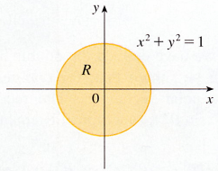
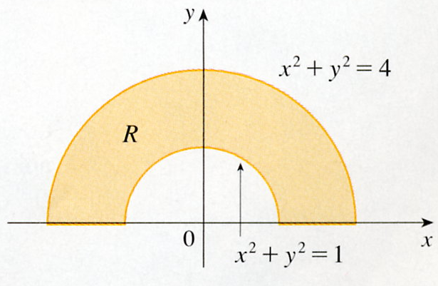
Suppose that we want to evaluate a double integral
f(x, y) dA,
Where R is one of the regions.
x² + y² =1
x² + y² =4
x² + y² =1
R=｛ (r,θ)｜0≦r≦1,
R=｛ (r,θ)｜1≦r≦2,
0≦θ≦2π｝
0≦θ≦π｝
Description of R, rectangular coordinates is complicated, using polar coordinates is easily.

Slide 3
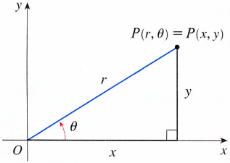
y
P(r, θ) = P(x, y)
r
y
θ
x
x
The rectangular coordinates (x, y)
r² = x² + y²
The polar coordinates (r, θ)
x = r cos θ
y = r sin θ

Slide 4
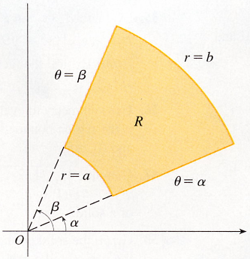
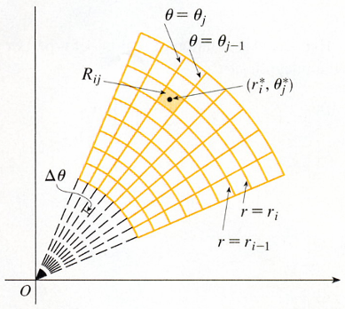
Dividing R into polar subrectangles The interval [a, b]
Polar rectangle
m subintervals [r_{i-1}, r_{i}]
equal width △r = (b – a)/m
The interval [α, β]
r=b
θ=β
n subintervals [θ_{j-1}, θ_{j}]
R
equal width △θ = (β – α)/n
θ=θ_{j}
r=a
θ=α
θ=θ_{j-1}
β
α
R_{ij}
(r_{i}*, θ_{j}*)
R ={(r, θ)｜a≦r≦b,
△θ
α≦θ≦β}
r=r_{i-1}
r=r_{i}

Slide 5

The center of the polar subrectangle
R_{ij} ={(r, θ)｜r_{i-1}≦r≦r_{i}, θ_{j-1}≦θ≦θ_{j}}
r_{i}* = 1/2(r_{i-1} + r_{i})
θ_{j}* = 1/2(θ_{j-1} + θ_{j})
△A_{i} = 1/2r_{i}²△θ – 1/2r²_{i-1} △θ
= 1/2( r²_{i} – r²_{i-1})△θ
θ=θ_{j}
θ=θ_{j-1}
= 1/2(r_{i} + r_{i-1})( r_{i} – r_{i-1})△θ
R_{ij}
(r_{i}*, θ_{j}*)
△A_{i}
= r*_{i}△r△θ
R
r*_{i}= 1/2(r_{i} + r_{i-1})
△θ
r=r_{i-1}
r=r_{i}
r*_{i}△θ
△r
△r= (r_{i} - r_{i-1})

Slide 6

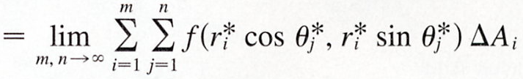

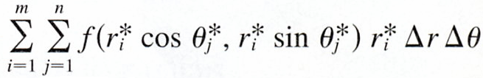

x_{i}*
,
y_{i}*
f (r*_{i} cosθ*_{j}, r*_{i} sinθ*_{j}) △A_{i}
f (r*_{i} cosθ*_{j}, r*_{i} sinθ*_{j}) r*_{i}△r△θ
f (r cosθ, r sinθ) r dr dθ

Slide 7

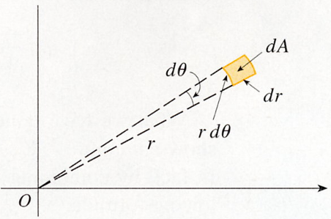
Change to Polar Coordinates in a Double Integral
If f is continuous on a polar rectangle R given by
0≦a≦r≦b, α≦θ≦β, 0≦β – α≦2π, then
f (r cosθ, r sinθ) r dr dθ
Be careful not to forget the additional factor r on the right side of Formula 2.
dA = r dr dθ
y = r sinθ
x = r cosθ

Slide 8

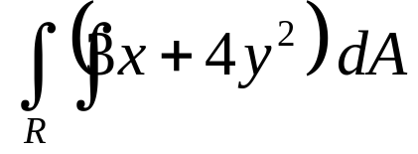
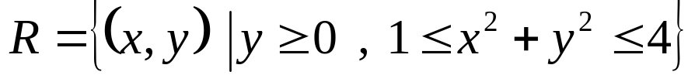
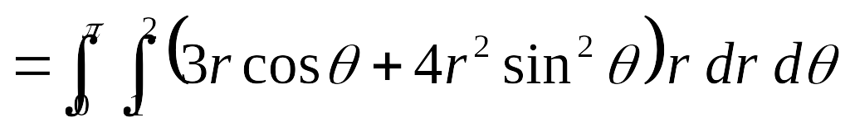
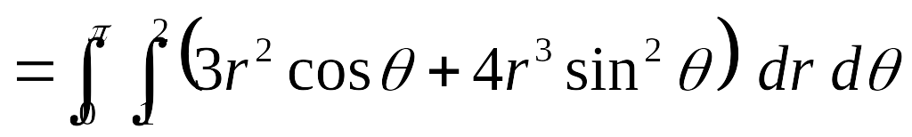
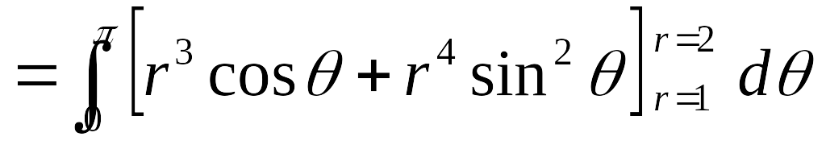

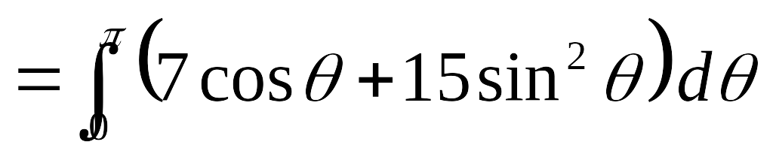
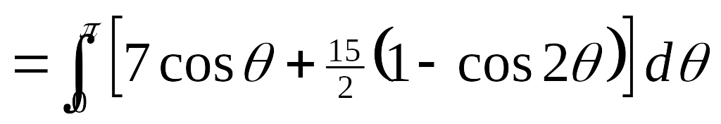


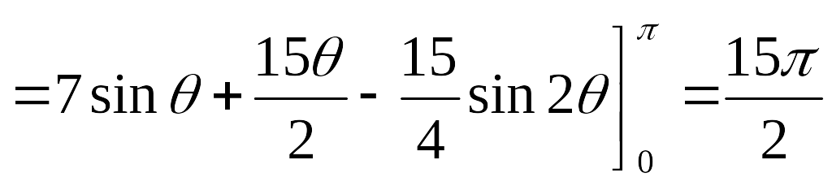
y
x² + y² = 4
R
x² + y² = 1
x

Slide 9


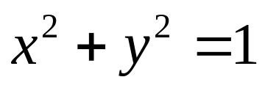
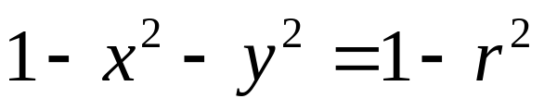
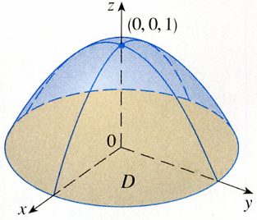
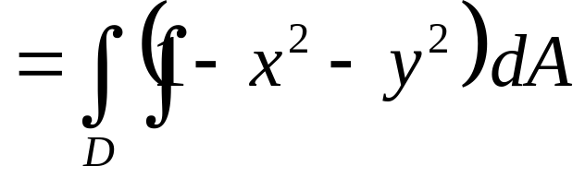

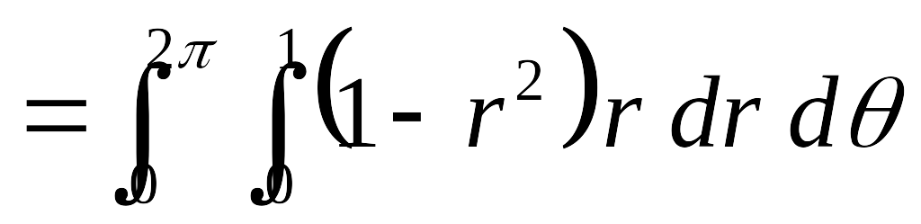
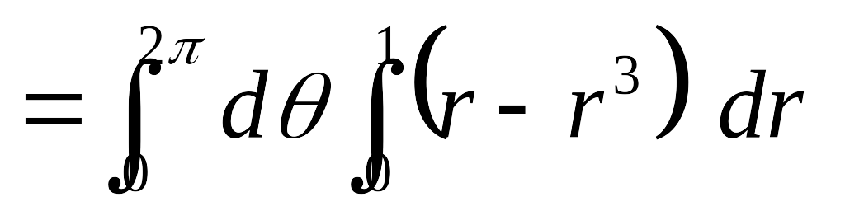
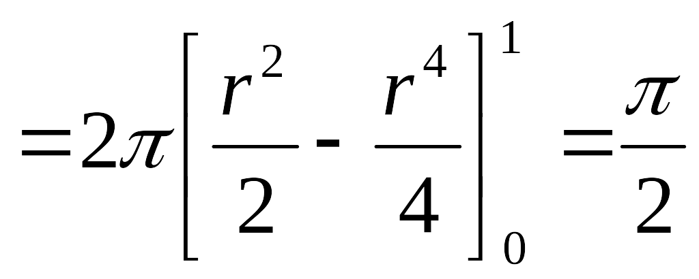
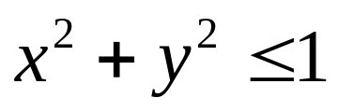
EXAMPLE 2
Find the volume of the solid bounded by the plane z = 0 and the paraboloid z = 1- x² – y²
SOLUTION

Slide 10
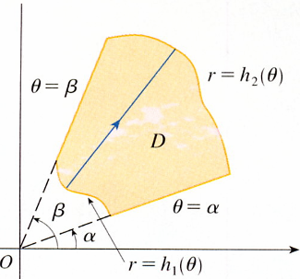


r = h₂(θ)
r = h₁(θ)
If f is continuous on a polar region of the form
D = {(r, θ)｜α≦θ≦β,
h₁(θ)≦r≦h₂(θ)}
h₂(θ)
f (r cosθ, r sinθ) r dr dθ
h₁(θ)

Slide 11

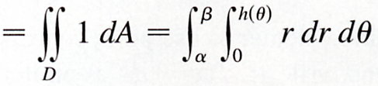
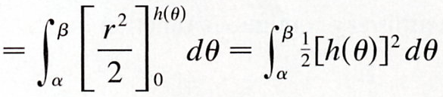
In particular, taking f(x, y) = 1, h₁(θ) =0, and h₂(θ) =h(θ)
The region D bounded by θ= α, θ = β, and r = h(θ)

Slide 12


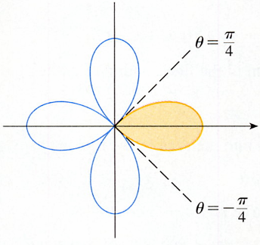





EXAMPLE 3 Use a double integral to find the area enclosed by one loop of the four-leaved rose r = cos 2θ.
SOLUTION
D = {(r,θ)｜-π/4≦θ≦π/4,
0≦r≦cos 2θ}

Slide 13
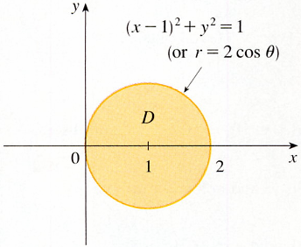
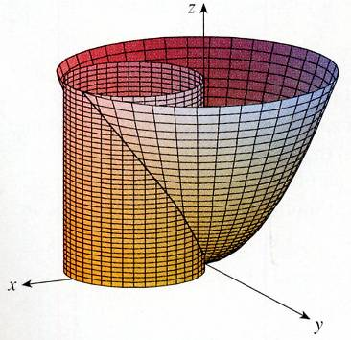
EXAMPLE 4 Find the volume of the solid that lies under the paraboloid z = x² + y², above the xy-plane, and inside the cylinder x² + y² = 2x.
π/2
SOLUTION
(x-1)² + y² =1
x² + y² = 2x
(x – 1)² + y² = 1
(r=2cosθ)
In polar coordinates
D
x = r cosθ
y = r sinθ
r² = 2r cos θ , r= 2cos θ
-π/2
The disk D is given by
D = {r, θ)｜-π/2≦θ≦π/2,
0≦r≦2 cos θ}
By Formula 3
f(x,y)= z = x² + y²

Slide 14
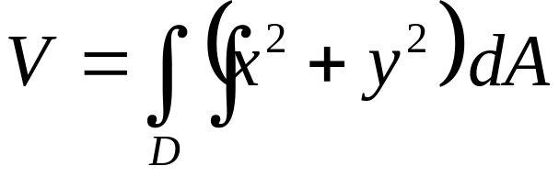
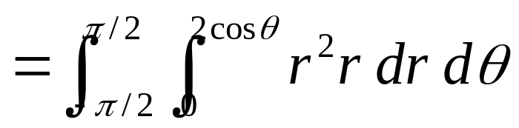
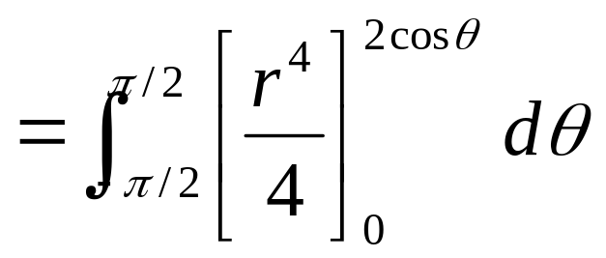

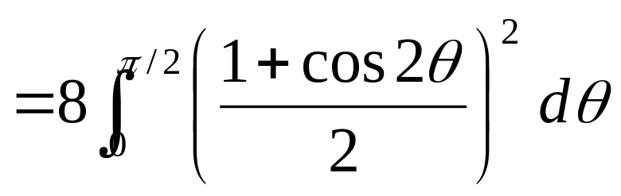
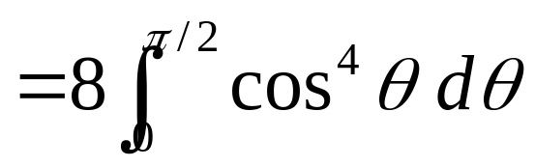
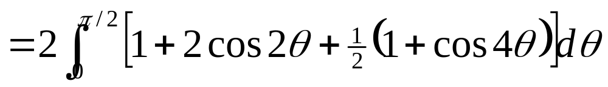
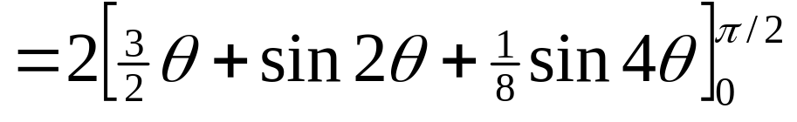
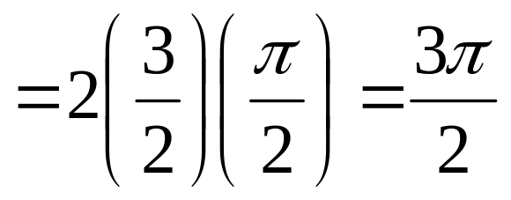
by Formula3

Slide 15
15-4 Exercises
EX25，EX31

